Slide 1

REGISTRARS OF COMPANIES DATA ANALYSIS
Created By
Neha K

Slide 2
DATASET OVERVIEW
Coverage: The dataset includes information on 1,68,165 registered companies across various ROC jurisdictions in India.
Company Profile: Contains details such as Company Name, Corporate Identification Number CIN, ROC Code, Company Category, Subcategory, and Class.
Financial Data: Includes Authorized Capital and Paid-up Capital figures for each company.
Operational Status: Tracks Listing Status (Listed/Unlisted) and Company Status Active, Strike Off, etc.
Geographical Data: Provides Registered Office Address and State Code for location insights.
Industry Classification: Captures the NIC Code and corresponding Industrial Classification to categorize business sectors.

Slide 3
TOOLS USED
SQL
Power BI

Slide 4
STEPS FOLLOWED
Imported the CSV file into SQL Server Management Studio (SSMS) for initial data analysis.
Identified inconsistencies and anomalies in the dataset through exploratory data checks.
Removed duplicate records and applied necessary formatting to ensure data cleanliness and consistency.
Exported the cleaned dataset and imported it into Power BI for visualization.
Developed insightful visualizations using appropriate charts to effectively represent key metrics and trends.

Slide 5
FINDINGS

Slide 6

1. What is the total number of companies recorded in the dataset?
There are totally 168,185 companies in the data.

Slide 7


2. How are the companies distributed across different categories?
Companies limited by shares are the most common, followed by companies limited by guarantee, while unlimited companies are the least common.

Slide 8

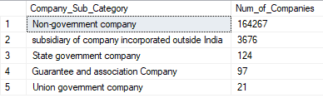
3. How are the companies distributed across different sub categories?
Non-government companies dominate the landscape, followed by a much smaller share of foreign subsidiaries, while Union government companies are the rarest.

Slide 9
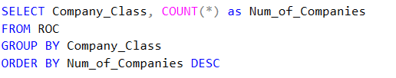

4. What is the total number of companies in each class?
Companies in the private sector are the most prevalent, followed by one person companies, while public sector companies are the least common.

Slide 10
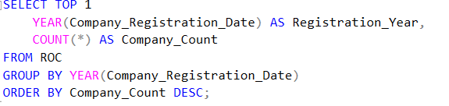

5.In which year was the highest number of companies registered?
1882 experienced highest number of registrations.

Slide 11
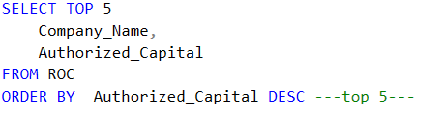
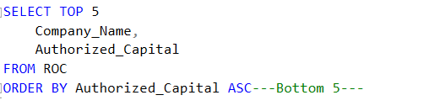
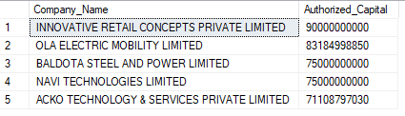
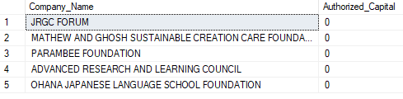
6.Which are the top 5 companies with the highest authorized capital and the bottom 5 with the lowest?

Slide 12
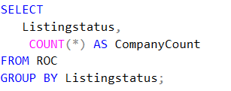

7.What is the number of listed and unlisted companies?
Unlisted companies are the most common, whereas listed companies are the least represented.

Slide 13
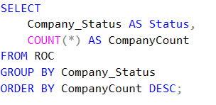
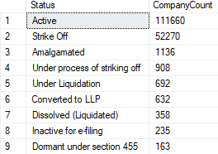

8. Present the count of companies based on their respective statuses?
Active companies are the most common, followed by those that are struck off, while dissolved companies are the least common.

Slide 14
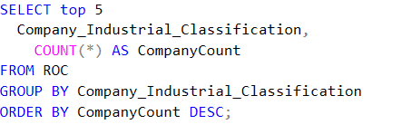
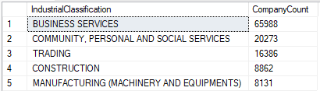
9.What is the number of companies categorized by industrial classification?
Business services companies are the most common, followed by those that are community services companies, while manufacturing companies are the least common.

Slide 15

10.Which company category has the highest authorized capital? Also, display the corresponding paid-up capital for each?

Slide 16
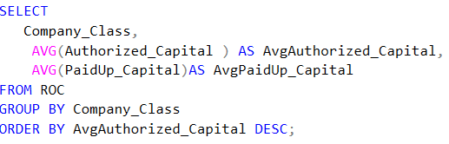

11.Categorize average authorized capital and average paid-up capital based on company class?
Public sector companies have the highest authorized capital, followed by private companies, while one person companies have the lowest.

Slide 17
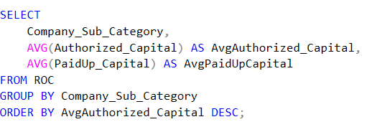
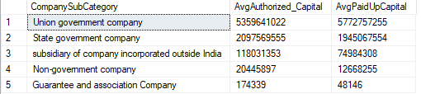
12. Categorize average authorized capital and average paid-up capital based on company sub category ?
Union government companies have the highest authorized capital, followed by state government companies, while guarantee and association companies companies have the lowest.

Slide 18
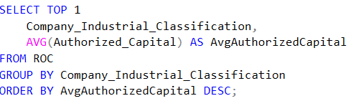
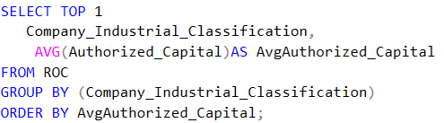


13.Which industry has highest average authorised capital and which has lowest authorised capital?
Insurance industry has highest authorized capital, while others have lowest .

Slide 19
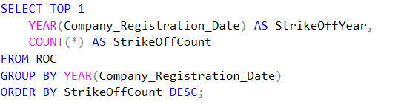

14. Which year saw the most company strike-offs?
Year 1882 has experienced highest strike off count.

Slide 20
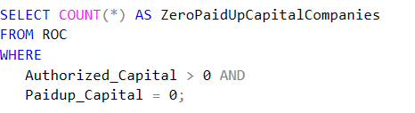

15. Are there any companies with authorized capital but zero paid-up capital?
There are totally 4,204 companies with zero paid up capital.

Slide 21
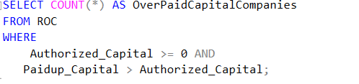

16. Are there companies where paid-up capital exceeds authorized capital?
There are totally 105 companies whose paid up capital exceeds authorized capital .

Slide 22
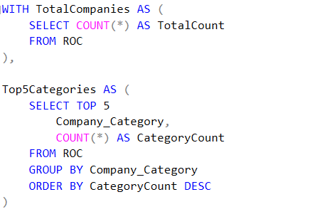

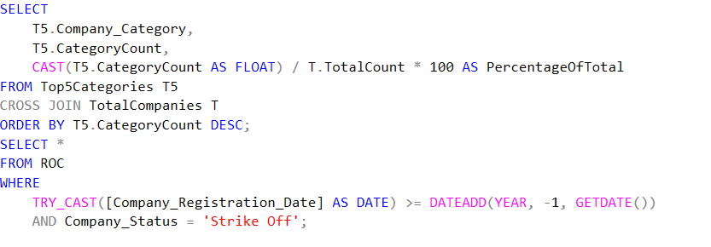
17. What percentage of companies fall into the top 5 most common company categories?

Slide 23

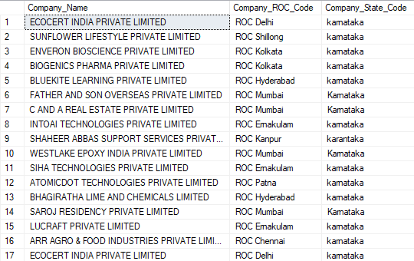
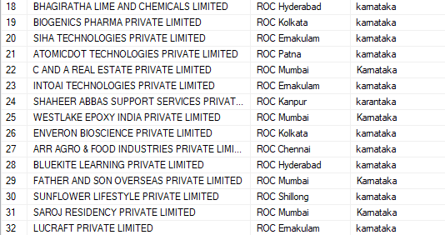
18. What percentage of companies fall into the top 5 most common company categories?

Slide 24
RECOMMENDATIONS

Slide 25
Given that companies limited by shares are the most common, a company seeking funding may consider adopting this structure to align with investor preferences and facilitate capital raising.
Since non-government companies dominate the market, other company types face less competition, making them a strategic choice for businesses seeking niche opportunities
Unlisted companies can consider going public, as listing may enhance their access to funding and increase market visibility.
Since many companies have been struck off, it is advisable for active companies to implement proper compliance and governance measures to avoid the risk of strike-off.
Although Innovate Concepts Private Limited has the highest authorized capital, its paid-up capital remains relatively low; therefore, it should consider measures to increase its paid-up capital to fully leverage its funding potential.
Given the high number of strike-offs in the year 1882, active companies should analyze the circumstances and causes from that period and develop strategies to prevent similar outcomes.

Slide 26
Compared to public and private companies, one person companies have a lower proportion of paid-up capital relative to their authorized capital; hence, they should take steps to increase their paid-up capital to improve financial credibility and operational capacity.
Companies with authorized capital but zero paid-up capital should take immediate measures to raise paid-up capital in order to activate their financial standing and begin operations effectively.
Companies with paid-up capital exceeding their authorized capital should take proactive measures to avoid unnecessary competition and ensure their financial structure remains sustainable

Slide 27
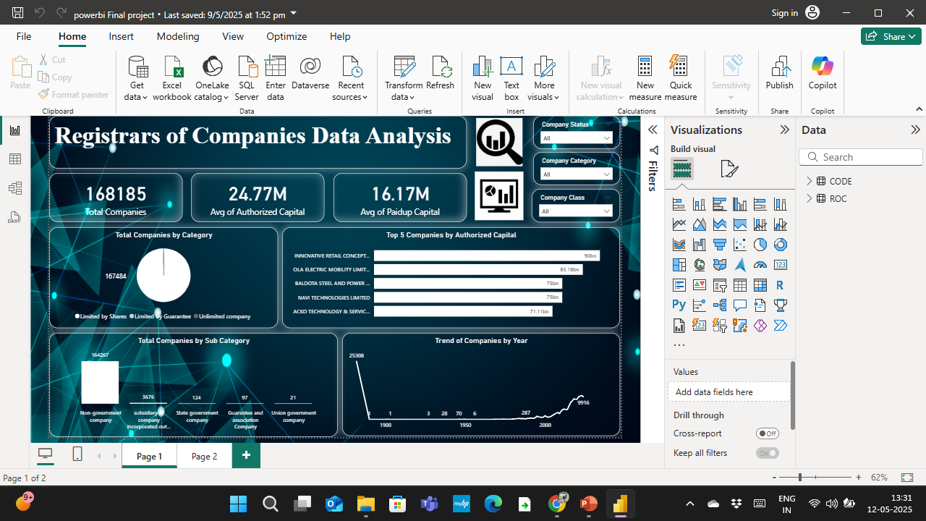

Slide 28
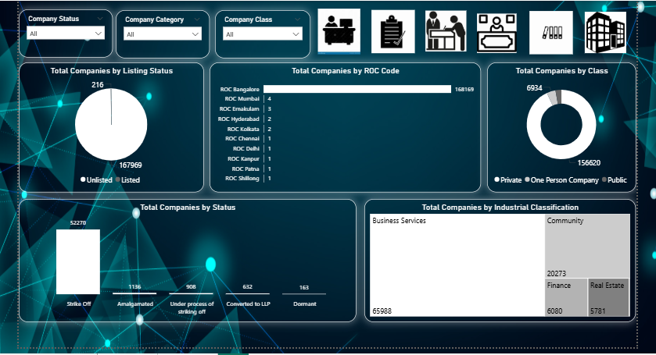

Slide 29
THANK YOU

